Slide 1

Azure Kubernetes Service Hackathon

Slide 2
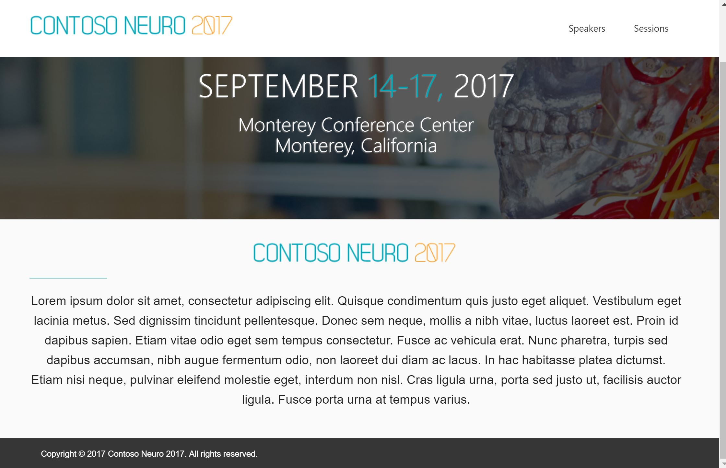
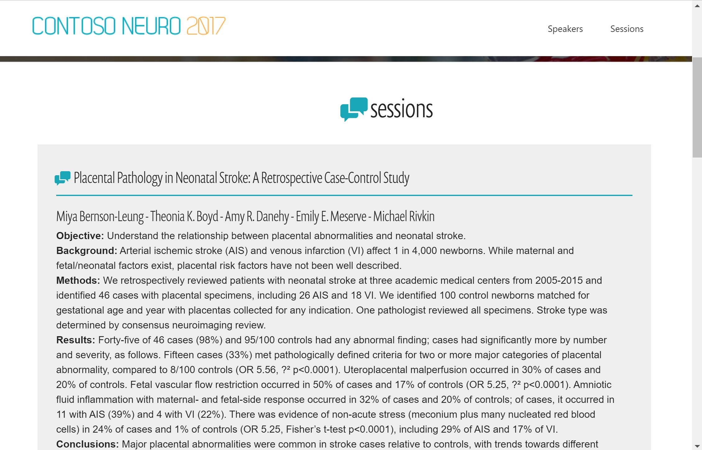

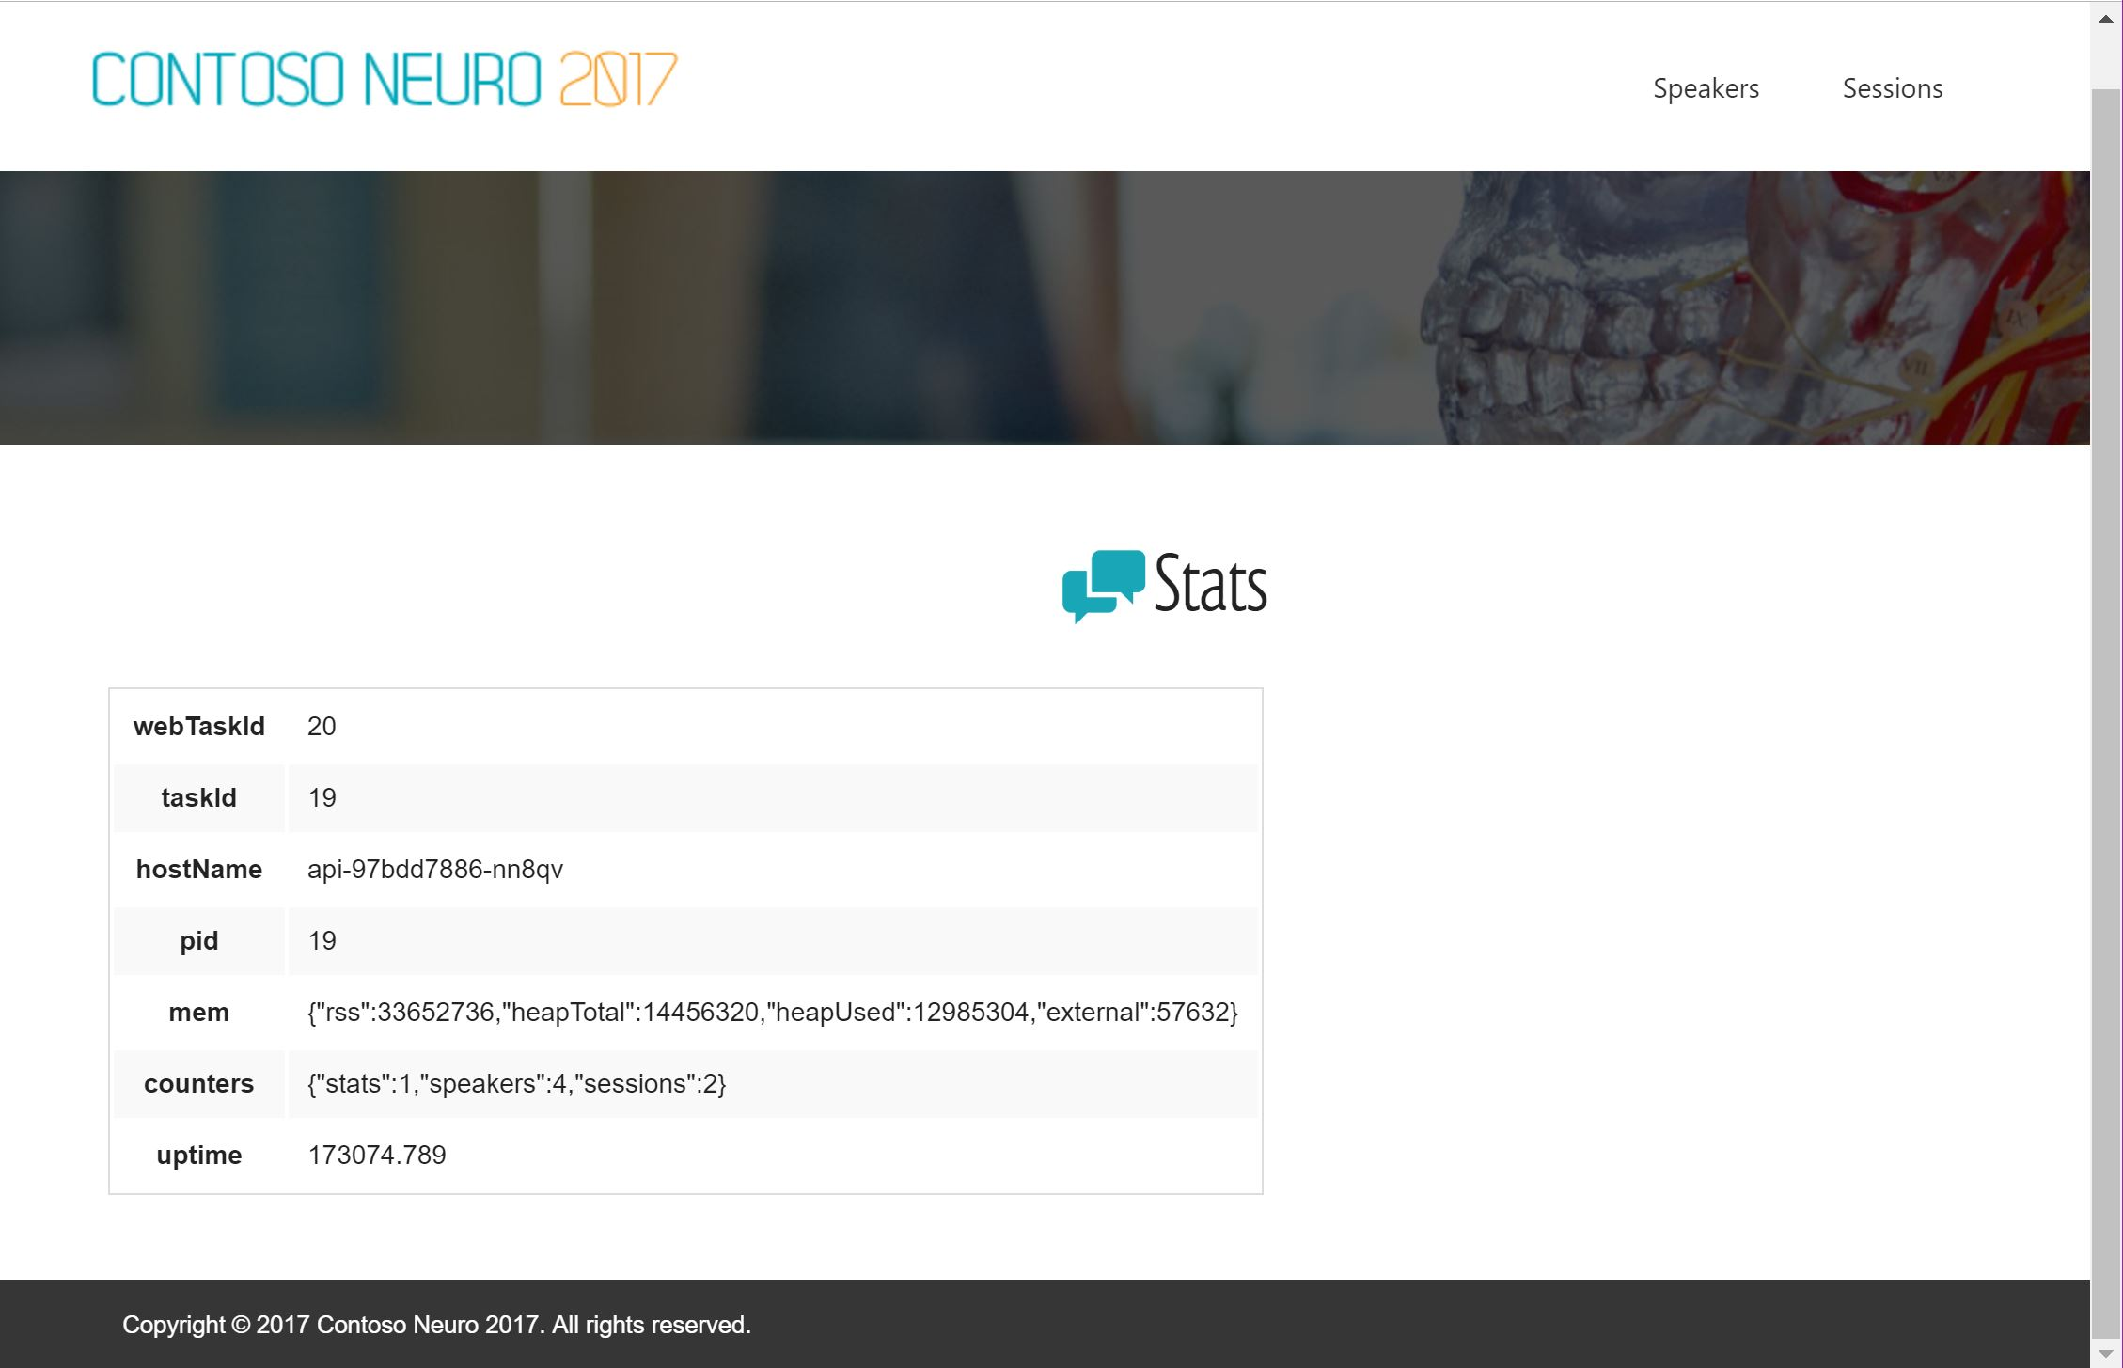
Challenge Scenario
Customer has existing web app, they want to modernize it and run it in containers in the cloud
Fab Medical conference website
Index.html
Sessions.html
Speakers.html
Stats.html
The web site is fully coded.
You do not need to modify it
Notes:
Note that there is a slight issue on the web site in that the speakers and sessions buttons to not appear unless the web site is full screen. Do not bother fixing this.

Slide 3
Fab Medical Conference Application
Simple Node.js application
Two components:
content-Web
Web site with 4 pages (home, sessions, speakers, and stats)
Each page hits a backend API to retrieve its content from a JSON datasource
content-API
3 functions that return pre-canned JSON data
Some of the scenarios pull the data from a Mongodb instance

Slide 4
Challenges…
Here’s our roadmap for the hack
Challenge 0: Pre-requisites - Ready, Set, GO!
Challenge 1: Got Containers? (Timeboxed)
Challenge 2: The Azure Container Registry
Challenge 3: Introduction To Kubernetes
Challenge 4: Your First Deployment
Challenge 5: Scaling and High Availability
Challenge 6: Deploy MongoDB to AKS
Challenge 7: Updates and Rollbacks
Challenge 8: Storage
Challenge 9: Helm (We might skip if we are time challenged)
Challenge 10: DNS & Ingress
Challenge 11: Private AKS Clusters
Challenge 12: Monitoring and Container Insights
Notes:
We are going to time box Challenge 1.

Slide 5
Challenge 0
Pre-requisites - Ready, Set, GO!
This should have already been done prior
You should have access to
a Linux machine containing the Fab Medical Application Code
a machine with a desktop (these machines could be the same)

Slide 6
Containers

Slide 7

Review: What is a Container?
Containers are an application-centric way to deliver high-performing, scalable applications on the infrastructure of your choice.

Slide 8
What is a Container?
VM
VM
VM
VM
App A
App B
App C
Guest OS
Guest OS
Guest OS
Guest OS
Hypervisor
Hypervisor
Host OS
Host OS
Server
Server

Slide 9
What is a Container?
VM
VM
VM
VM
App A
App B
App C
Guest OS
Guest OS
Guest OS
Container Engine
Guest OS
Hypervisor
Hypervisor
Host OS
Host OS
Server
Server

Slide 10
What is a Container?
VM
VM
VM
VM
App A
App B
App C
Container
App A
Guest OS
Guest OS
Guest OS
Bins/Libs
Container Engine
Guest OS
Hypervisor
Hypervisor
Host OS
Host OS
Server
Server

Slide 11
What is a Container?
VM
VM
VM
VM
App A
App A
App B
Container
Container
Container
App A
App B
App C
Guest OS
Guest OS
Guest OS
Bins/Libs
Bins/Libs
Bins/Libs
Container Engine
Guest OS
Hypervisor
Hypervisor
Host OS
Host OS
Server
Server

Slide 12
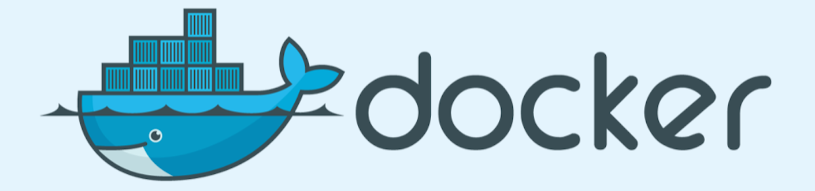
What is a Container?
VM
VM
VM
VM
App A
App A
App B
Container
Container
Container
App A
App B
App C
Guest OS
Guest OS
Guest OS
Bins/Libs
Bins/Libs
Bins/Libs
Container Engine
Guest OS
Hypervisor
Hypervisor
Host OS
Host OS
Server
Server

Slide 13


Container Engines
On The AKS Cluster
Supports the Docker Image Format – as an option
On Your Desktop
Notes:
Show Docker images on the machine
Show Docker images running on the machine
Quick demo a Dockerfile?

Slide 14
Challenge 1
Got Containers?
Create Docker images for both the API & Web app
Run the containers and verify that you can access the app locally
Before we start, we are going to show you how the app runs outside of a container
This will be a timeboxed challenge

Slide 15
What is a Container Registry?

Slide 16
What is a Container Registry?
A place to store, list, and share your container images
Like an “app store” for container images
DockerHub is a registry hosted by Docker. Many companies publish their containers there.
Most cloud providers offer their own Cloud Registries “as-a-service”
Azure has the… “Azure Container Registry”! GitHub has “GitHub Container Registry”
Docker tools can publish to a container registry
Docker can run a container image from a registry

Slide 17

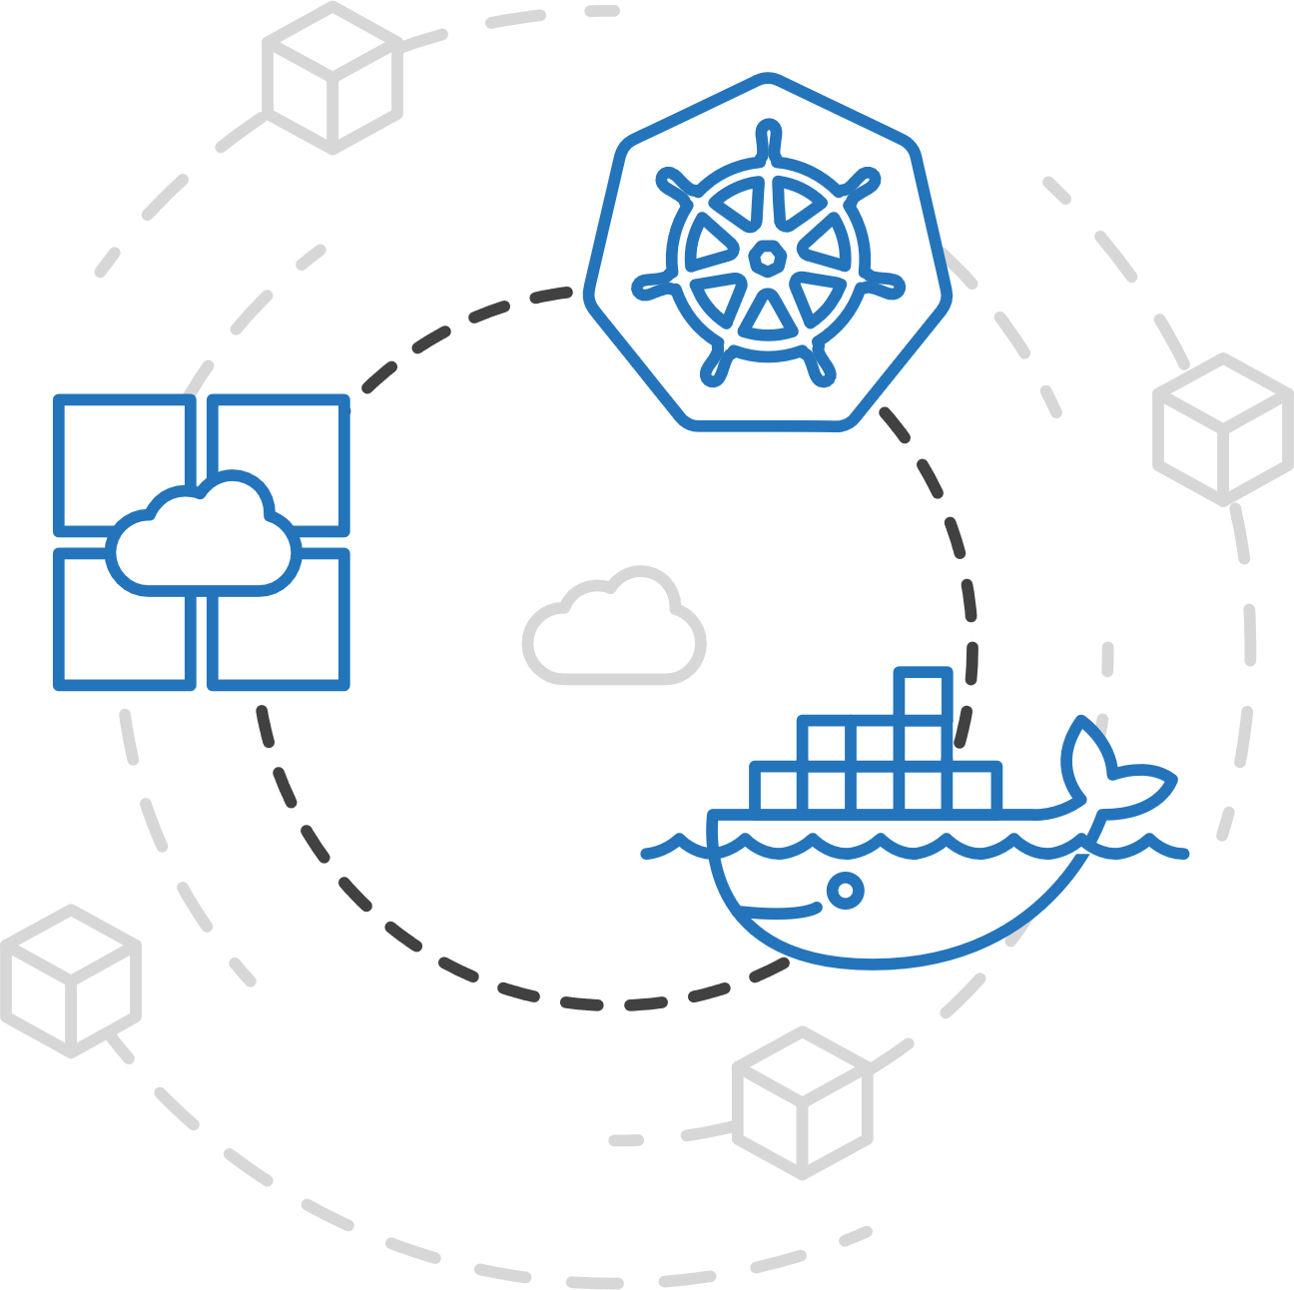
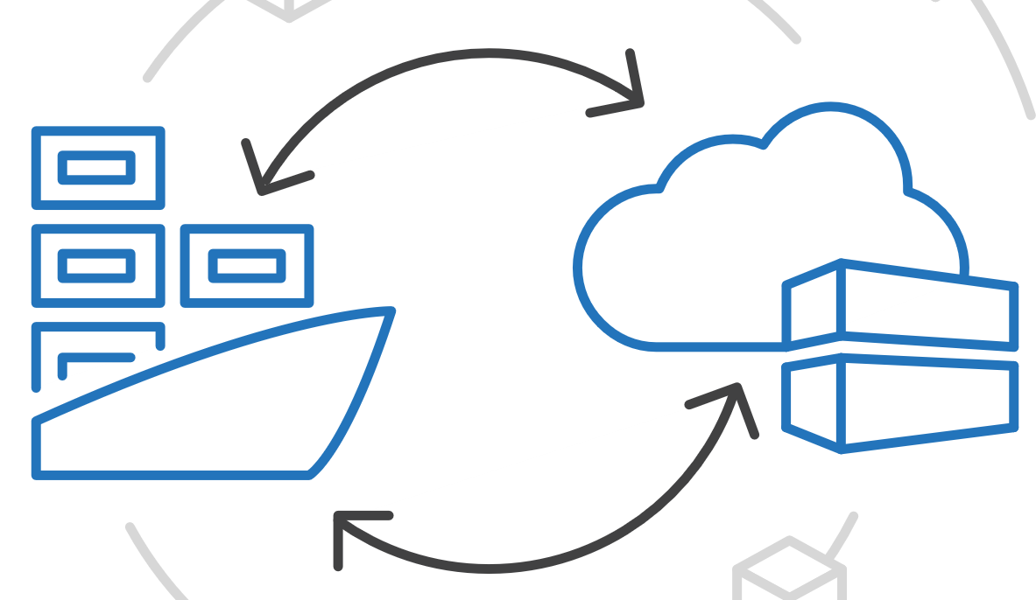
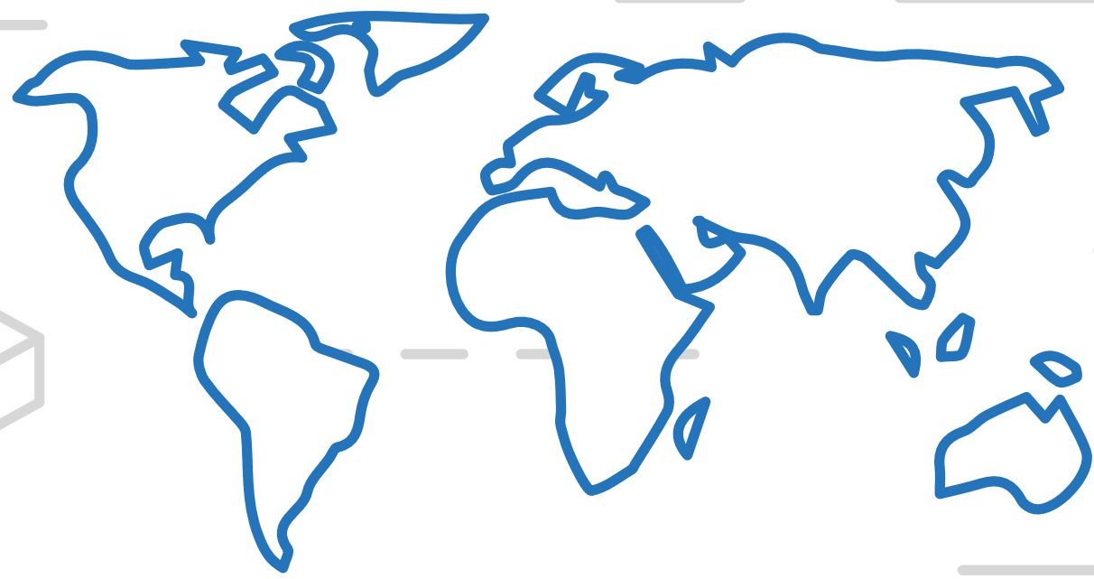


Azure Kubernetes Service (AKS)
Azure Container Registry (ACR)
Manage a Docker private registry as a first-class Azure resource
App Service
Azure Container Instances (ACI)
Service Fabric
Manage images for all types of containers
Use familiar, open-source Docker CLI tools
Azure Container Registry geo-replication
Azure Batch
Azure Container Registry (ACR)
Notes:
Encrypted At Rest
Geo-redundant storage for all tiers – ^{Azure Storage GRS}
Docker & OCI Image Formats
Helm Charts – first public cloud to support Helm Chart Repos
Providing multi-container, parameterized definitions

Slide 18
What is a Container Registry?
VM
Container
Container
Container
Container Registry
App A
App B
App C
Container Image
Container Image
Bins/Libs
Bins/Libs
Bins/Libs
Container Image
Container Engine
Container Image
Guest OS
Container Image
Hypervisor
Container Image
Host OS
Server

Slide 19
Challenge 2
The Azure Container Registry
Create an Azure Container Registry
Either:
Publish your content-api & content-web containers to the ACR
Have the ACR rebuild your containers in Azure and store them

Slide 20
Ok, I’ve got containers.
And a registry.
Now what?

Slide 21
I’m going to want more VMs with containers!
VM
VM
Container
Container
Container
Container
Container
Container
App A
App B
App C
App A
App B
App C
Bins/Libs
Bins/Libs
Bins/Libs
Bins/Libs
Bins/Libs
Bins/Libs
Container Engine
Container Engine
Guest OS
Guest OS
Hypervisor
Hypervisor
Host OS
Host OS
Server
Server

Slide 22
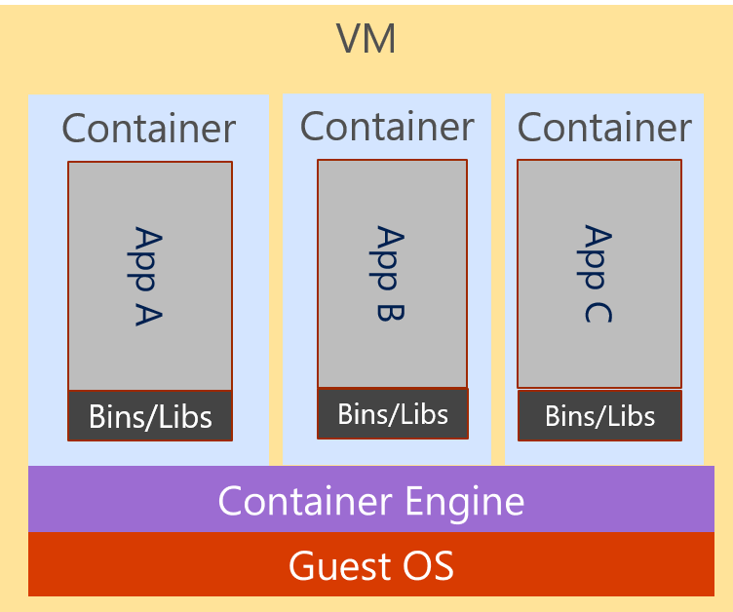
And more… and more!

Slide 23
And more… and more… How to manage?

Slide 24
What is a Container Orchestrator?

Slide 25
What is a Container Orchestrator?
Container Orchestrator

Slide 26
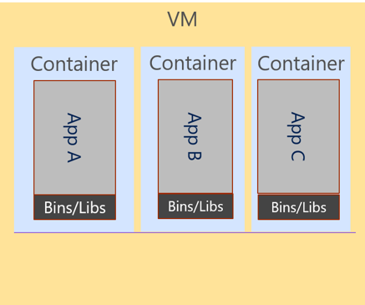
What is a Container Orchestrator?
Cluster
Container Orchestrator

Slide 27
What is a Container Orchestrator?
Cluster
VM
Container Orchestrator
Guest OS
Hypervisor
Host OS
Server

Slide 28
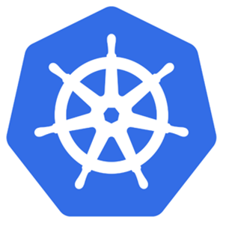
Kubernetes is a Container Orchestrator!
Cluster
VM
Kubernetes
Guest OS
Hypervisor
Host OS
Server

Slide 29
The elements of orchestration
Scheduling
Affinity/anti-affinity
Health monitoring
Failover
Scaling
Networking
Service discovery
Coordinated app upgrades

Slide 30
Kubernetes has a Master & Cluster of “Nodes”
Cluster
VM
Master Node
Kubernetes
Node
Node
Node
Node
Node
Node
Guest OS
Hypervisor
Host OS
Server

Slide 31
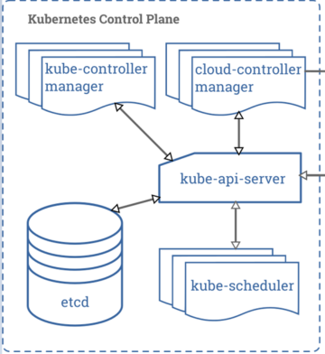
Kubernetes has a Master & Cluster of “Nodes”
VM
Cluster
Master Node
Kubernetes
Node
Node
Node
Node
Node
Node
Guest OS
Hypervisor
Host OS
Server

Slide 32
Azure Kubernetes Service (AKS)
AKS reduces the complexity and operational overhead of managing Kubernetes by offloading much of that responsibility to Azure.
AKS provides the master nodes as part of the service

Slide 33
Azure Kubernetes Service (AKS)
Azure Kubernetes Service (AKS)
Get started easily
$ az aks create -g myResourceGroup -n myCluster --generate-ssh-keys
\ Running ..
$ az aks install-cli
Downloading client to /usr/local/bin/kubectl ..
$ az aks get-credentials -g myResourceGroup -n myCluster
Merged "myCluster" as current context ..
$ kubectl get nodes
NAME STATUS AGE VERSION
aks-mycluster-36851231-0 Ready 4m v1.8.1
aks-mycluster-36851231-1 Ready 4m v1.8.1
aks-mycluster-36851231-2 Ready 4m v1.8.1

Slide 34
Azure Kubernetes Service (AKS)
Azure Kubernetes Service (AKS)
Manage an AKS cluster
$ az aks list –o table
Name Location ResourceGroup KubernetesRelease ProvisioningState
------------------ ---------- -------------- ------------------- -------------------
myCluster westus2 myResourceGroup 1.7.7 Succeeded
$ az aks upgrade -g myResourceGroup -n myCluster –-kubernetes-version 1.8.1
\ Running ..
$ kubectl get nodes
NAME STATUS AGE VERSION
aks-mycluster-36851231-0 Ready 12m v1.8.1
aks-mycluster-36851231-1 Ready 8m v1.8.1
aks-mycluster-36851231-2 Ready 3m v1.8.1
$ az aks scale -g myResourceGroup -n myCluster --agent-count 10
\ Running ..

Slide 35
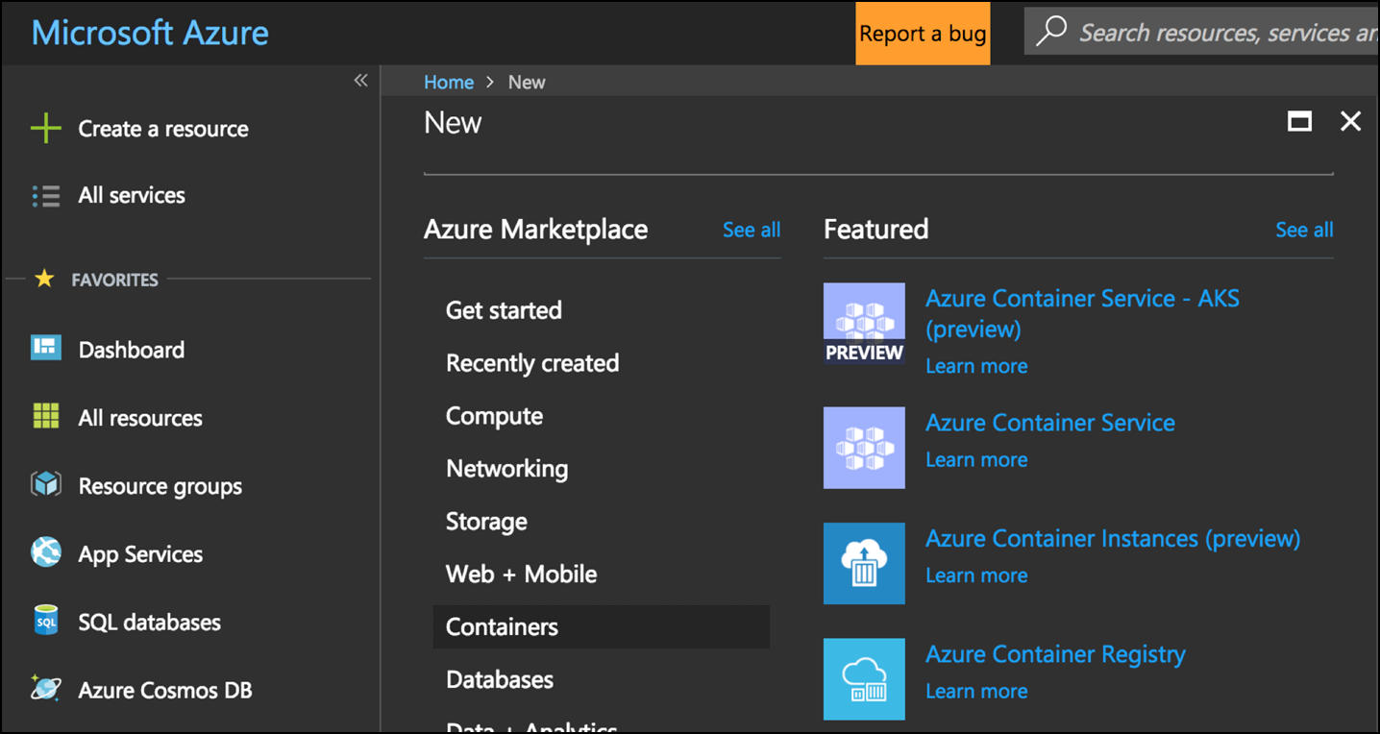
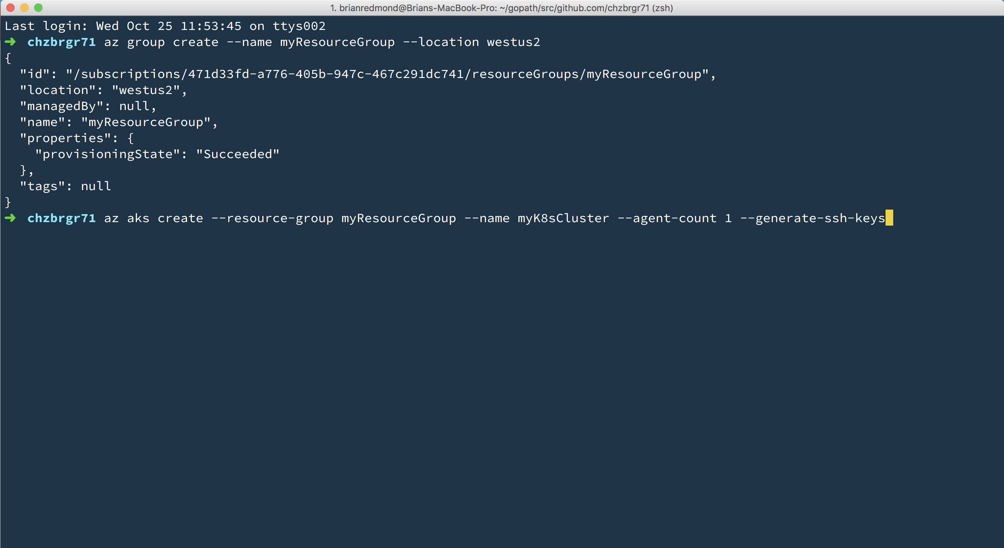
Azure Kubernetes Service (AKS)
Azure Kubernetes Service (AKS)
Create AKS via Portal, Azure CLI, or ARM template

Slide 36
Challenge 3
Introduction To Kubernetes
Install an AKS cluster

Slide 37
Kubernetes Fundamentals Pods, Deployments, & Services

Slide 38
Kubernetes @ 10,000ft
Cluster
Kubernetes
Master
Node
Node
Node
Node
Node
Node

Slide 39
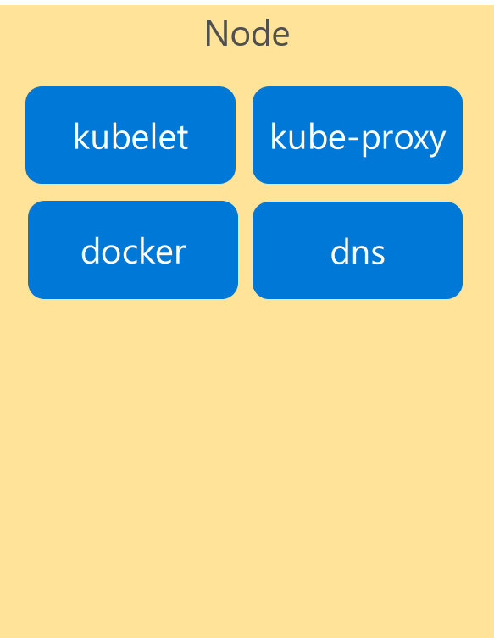
Kubernetes Architecture Components
Cluster
Master
Node
api-server
kubelet
kube-proxy
controller-manager
docker
dns
etcd
scheduler
*Azure Managed
Notes:
If we look inside the VM nodes in a Kubernetes clusters, we’ll see a whole set of services that are running on each.
These are containers themselves!
These services are how Kubernetes handles management of the nodes and things that run on them.
I’m going explain these now briefly…

Slide 40
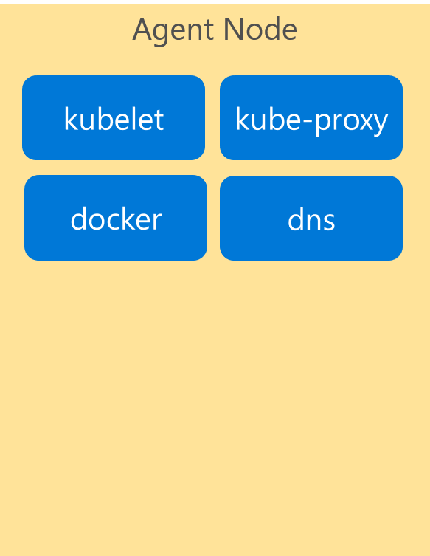
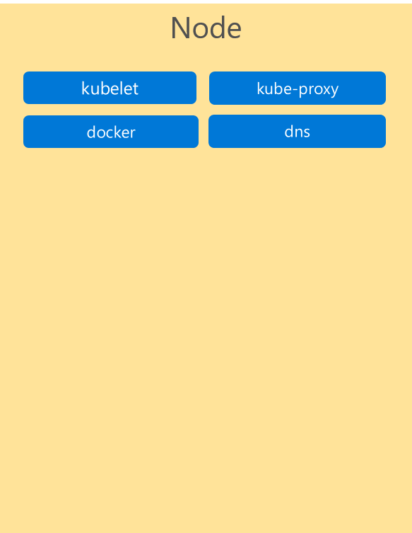
Kubernetes Architecture Components
Cluster
Master
Node
Kube stuff
Kube stuff
api-server
kubelet
kube-proxy
docker
dns
controller-manager
etcd
scheduler
*Azure Managed
Notes:
Now all of these services… forget about them for now!
They’re just the stuff that makes Kubernetes run.
You can read all about them in the docs, and probably will learn more about them as you become more familiar with the system.
But for today… we want to focus on the core components and concepts.
IF you focus on these, you’ll get lost.
Let’s keep it simple for now.

Slide 41
Kubernetes Architecture Components
Where do the Containers go?
Container
Container
Container
App A
App B
App C
Bins/Libs
Bins/Libs
Bins/Libs

Slide 42
Kubernetes Architecture Components
Introducing…. Pods!
Pod
Pod
Pod
Container
Container
Container
App A
App B
App C
Bins/Libs
Bins/Libs
Bins/Libs
Containers go inside Pods!

Slide 43
Kubernetes Architecture Components
Pods
Cluster
Master
Node
Kube stuff
Kube stuff
api-server
kubelet
kube-proxy
docker
dns
controller-manager
Pod
App A
Pod
App B
Pod
App C
etcd
scheduler
*Azure Managed
Notes:
Here are some pods running on one node in our cluster

Slide 44
Kubernetes Architecture Components
Pods
Cluster
Master
Node
Kube stuff
Kube stuff
api-server
kubelet
kube-proxy
docker
dns
Pod
App A
Pod
App B
Pod
App D
controller-manager
Pod
App A
Pod
App B
Pod
App C
etcd
scheduler
Pod
App C
Pod
App C
*Azure Managed
Notes:
Here are some pods running across multiple nodes on our cluster…

Slide 45
Pods – What are they?
Metadata that describes how the containers are configured.
Metadata. They’re just metadata!
pod
pod
ratings-web
Label(s) | app=ratings-web
Container-image | my.azurecr.io/ratings-web
Port | 3000
(VolumeMount) | /mnt/share
(Resources) | <cpu/memory>
ratings-api
Label(s) | app=ratings-api
Container-image | my.azurecr.io/ratings-api
Port | 3001
(VolumeMount) | /mnt/share
(Resources) | <cpu/memory>
pod
otherApp
Label(s) | app=otherApp
Container-image | other.azurecr.io/otherApp
Port | 4045
(VolumeMount) | /mnt/share
(Resources) | <cpu/memory>
Notes:
What is that metadata
Image
Port
Storage/resources
Label=important
<click>more<click>more

Slide 46
Deployments
Metadata that describes how to deploy a pod
Deployment
ratings-web
replicas | 2
pod
ratings-web
Label(s) | app=ratings-web
Container-image | my.azurecr.io/ratings-web
Port | 3000
(Volume) | …
(Resources) | …
Notes:
How do I deploy a pod?? With a deployment. Again more metadata.
Replicas == scale == desired state (more on that later)
WHY you want one container per pod: Because pod is the unit of scale

Slide 47
Services
Metadata that describes how to reach the pods
pod
ratings-web1
Label(s) | app-ratings-web
Container-image | my.azurecr.io/ratings-web
Port | 3000
Service
ratings-web
Selector | app=ratings-web
Port Mapping | 3000:8080
Type | Internal or External
pod
ratings-web2
Label(s) | app-ratings-web
Container-image | my.azurecr.io/ratings-web
Port | 3000
Notes:
Next concept: SERVICES
A load balancer for pods
Metadata that describes how to reach a pod, any number of instances.
Internal or External
<click then more details>

Slide 48
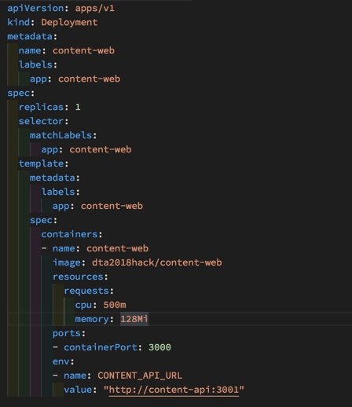
Deployments in Kubernetes
Config-as-Code as a YAML file

Slide 49
Challenge 4
Your First Deployment
Deploy the Fab Medical API service and test the API app from a local shell in the pod
Deploy the Fab Medical Web and ensure that the Web app knows where to find the API service deployed previously.
Create a service for the web app that is accessible from outside the cluster.
Test the app and make sure speakers and session lists are showing.

Slide 50
Kubernetes Scaling & HA

Slide 51
Scaling Pods
Cluster
Master
Node
Node
Node
Kube stuff
Kube stuff
Kube stuff
Kube stuff
Pod
ratings-web1
Pod
ratings-web3
Pod
ratings-web5
*Azure Managed
Deployment
SCALE pods!
Pod
ratings-web2
Pod
ratings-web4
Pod
ratings-web6
Notes:
Here’s what a rolling update looks like if we update the deployment with new a new version of the app

Slide 52
Scaling Nodes
Cluster
Master
Node
Node
Node
Node
Kube stuff
Kube stuff
Kube stuff
Kube stuff
Kube stuff
Pod
ratings-web1
Pod
ratings-web2
Pod
ratings-web3
Pod
ratings-web4
*Azure Managed
Pod
ratings-api1
Pod
ratings-api2
Pod
ratings-api3
Pod
ratings-web5
az aks scale –name myAKSCluster –g myRG –node-count 4
Notes:
K8S doesn’t manage infrastructure!
You would need to stand up VMs, manually (or scripted) install all the “kube stuff” in the black boxes
Log into the master and add those things
Here’s what it looks like to scale nodes, and then pods!
If K8S was in a state where it had NO resources, it would just fulfill its desired state destiny!

Slide 53
Scaling “Virtual” Nodes With Azure Container Instances
Cluster
Azure Container Instances
Master
Node
Node
Kube stuff
Kube stuff
Kube stuff
Pod
ratings-web1
Pod
ratings-web2
Pod
ratings-web3
Pod
ratings-web4
*Azure Managed
Pod
ratings-api1
Pod
ratings-api2
Pod
ratings-api3
Pod
ratings-web5
az aks enable-addons –g myRG –name myAKSCluster
–addons virtual-node –subnet-name myVirtualNodeSubnet
Notes:
ACI is a service that lets you run Containers on Azure Infrastructure.
You don’t worry about VMs. Just run containers… as a service!
Microsoft INNOVATION – virtual nodes
Tell K8S to view ACI as a giant “node” with unlimited resources!

Slide 54
Challenge 5
Scaling and High Availability
Modify and re-apply your YAML files to scale your apps.
Scale the web app to 2 instances
Scale the API app to 4 instances
Fix any capacity issues that arise.
Inspect how the load balancer changes its redirection of traffic during scaling.
Configure your cluster with the cluster autoscaler.

Slide 55
Fab Medical v2
Let’s make it more robust
Replace the backend (content-api) with a new version that retrieves the data from a MongoDB
Add a daemon job (content-init) that runs one time to initialize and populate the MongoDB with the data
This code already exists, you’re just going to package & deploy it!

Slide 56
Challenge 6
Deploy MongoDB to AKS
Deploy MongoDB from a public container registry (hint: DockerHub!)

Slide 57
Rolling Updates & Roll-Backs
Cluster
Master
Kube stuff
Service
ratings-web
IP Address
Pod
App V1
Pod
App V2
Pod
App V1
Pod
App V2
Pod
App V1
Pod
App V2
*Azure Managed
Deployment
(with pod updates)
Updated App
Updated App
Updated App
Notes:
Here’s what a rolling update looks like if we update the deployment with new a new version of the app

Slide 58
Blue – The Initial Deployment
Cluster
Master
Node
Node
Node
Kube stuff
Service
ratings-web
IP Address
Pod
App V1
Pod
App V1
Pod
App V1
*Azure Managed
Notes:
Here’s what a rolling update looks like if we update the deployment with new a new version of the app

Slide 59
POP QUIZ !!
Green – The New Deployment
POP QUIZ !!
Cluster
Master
Node
Node
Node
Kube stuff
Service
ratings-web
IP Address
Pod
App V1
Pod
App V1
Pod
App V1
*Azure Managed
Deployment
(with pod updates)
Service configuration
update
Pod
App V2
Pod
App V2
Pod
App V2
Notes:
Blue Green deployment definition
Need head room to do this
This is like Deployment slots in App Service Web Apps

Slide 60
Challenge 7
Updates and Rollbacks
Perform a rolling update to a new version of the Web app
Watch how the update rolls out by testing the Web app.
Roll back to the original version.
Perform the update again, this using the blue/green methodology.

Slide 61
Kubernetes - Storage

Slide 62
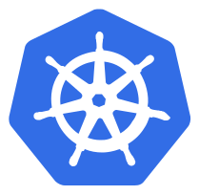


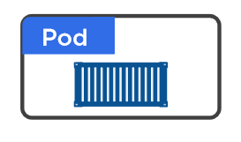
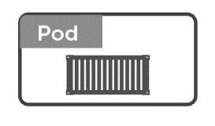
Volumes in Kubernetes
Why we need to volumes ?
On-disk files in a Container
are
ephemeral
Volume
(state)

Slide 63
Volumes in Kubernetes
Different Types
Volumes
emptyDir
hostPath
Cloud Volumes
Persisted Volum Claim (PVC)
ConfigMap
Security
….
RAM
HDD /SSD

Slide 64
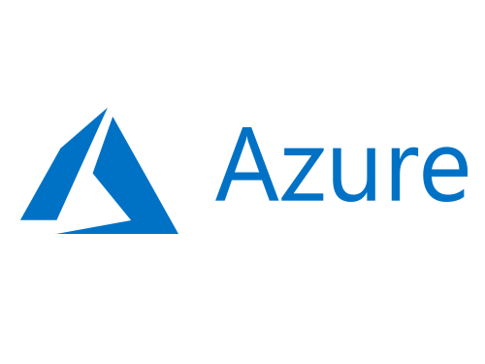

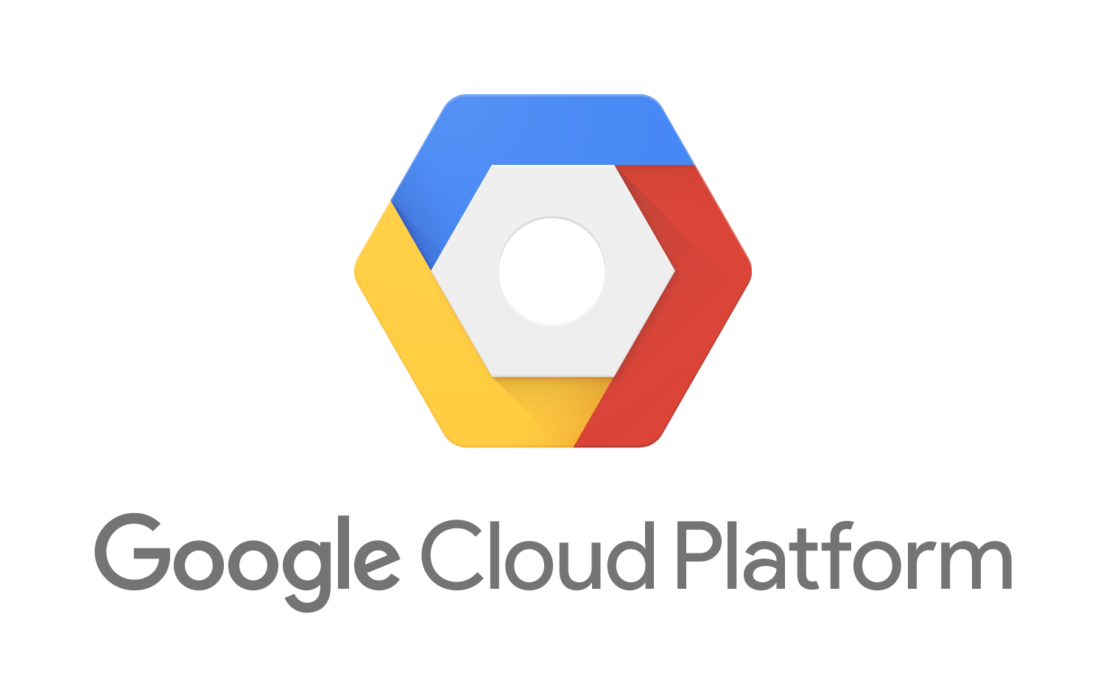
Volumes in Kubernetes
Different Types of Volumes
Volumes
emptyDir
hostPath
Cloud Volumes
Persisted Volum Claim (PVC)
ConfigMap
Security
….

Slide 65



Volumes in Kubernetes
PV vs PVC
Volumes
emptyDir
hostPath
Cloud Volumes
Persisted Volum Claim (PVC)
ConfigMap
Security
….
Cluster Admin
Persisted Volume
(static)
Developer
Storage Class
(dynamic)

Slide 66
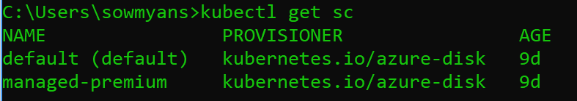
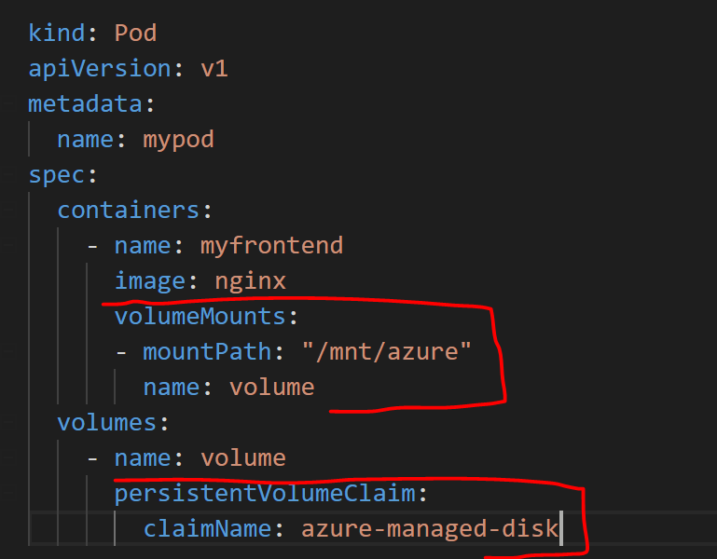
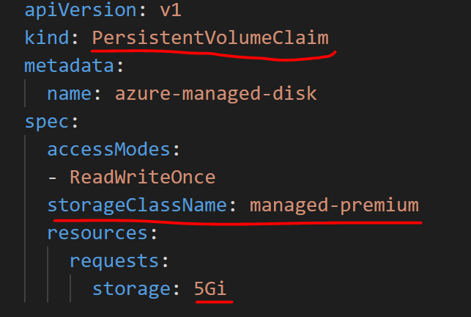
Volumes in Kubernetes
Dynamic Storage in AKS – Azure Disk

Slide 67

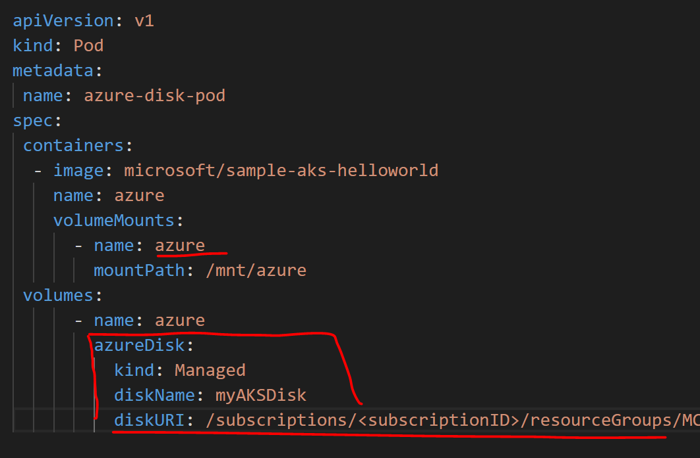
Volumes in Kubernetes
Static Storage in AKS – Azure Disk
az disk create \ --resource-group MC_myResourceGroup_myAKSCluster_eastus \ --name myAKSDisk \ --size-gb 20 \ --query id --output tsv
/subscriptions/<subscriptionID>/resourceGroups/MC_myAKSCluster_myAKSCluster_eastus/providers/Microsoft.Compute/disks/myAKSDisk

Slide 68
Challenge 8
Storage
Create Azure Disks
Deploy the mongo Db with persisted storage
Initialized the sample content – speakers & session
Destroy the mongo Db and recreate and verify that the data is persisting

Slide 69
Kubernetes Package Management Helm

Slide 70
Notes:
NPM, apt get, brew install
Helm is a package manager like Homebrew, apt, and yum, and it’s the defacto standard for packaging and deploying Kubernetes applications. Microsoft donated Helm to the Cloud Native Computing Foundation (CNCF) back in June 2018, and it’s on track for graduation in 2020. Helm was used by 68% of respondents of a CNCF user survey. And it was the 3rd most popular project at the last KubeCon in Barcelona. We use Helm in AKS, azure dev spaces, azure pipelines, azure devops.

Slide 71
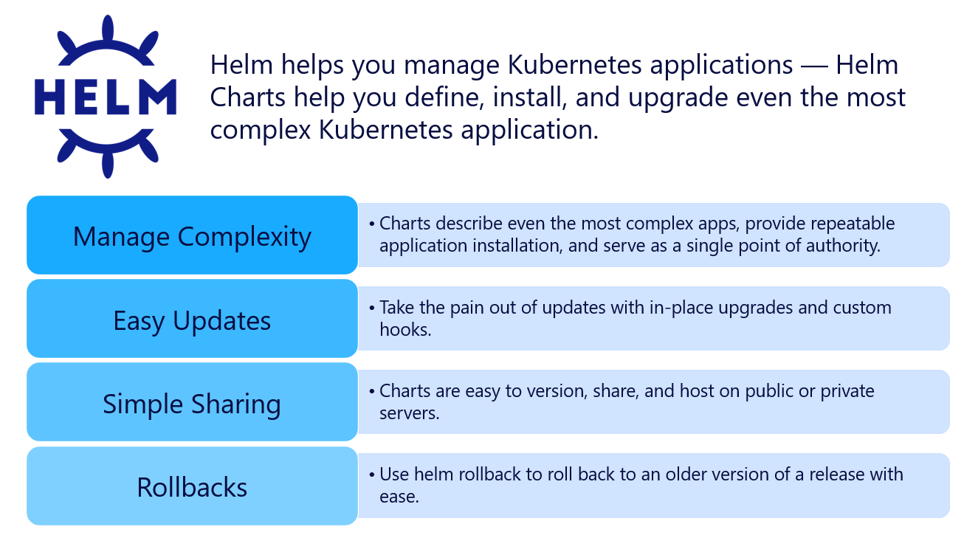

Slide 72
The Purpose of Helm
Helm is a tool for managing Kubernetes packages called charts. Use existing charts or create your own. Helm can do the following:
Create new charts from scratch
Package charts into chart archive (tgz) files
Interact with chart repositories where charts are stored
Install and uninstall charts into an existing Kubernetes cluster
Manage the release cycle of charts that have been installed with Helm

Slide 73
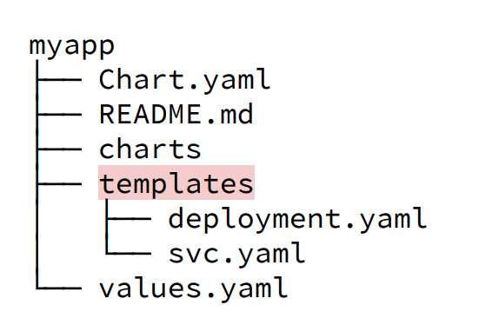
Helm – Key Concepts
The chart is a bundle of information necessary to create an instance of a Kubernetes application.
The config contains configuration information that can be merged into a packaged chart to create a releasable object.
A release is a running instance of a chart, combined with a specific config.

Slide 74
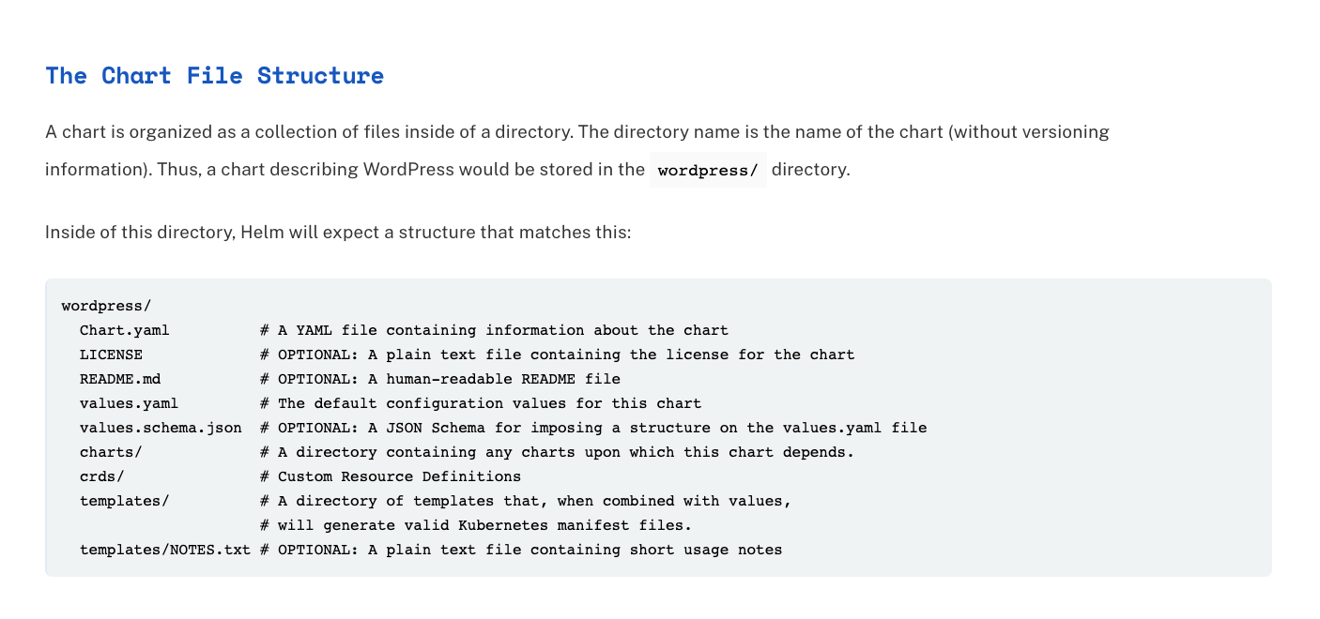
Helm – Key Concepts

Slide 75
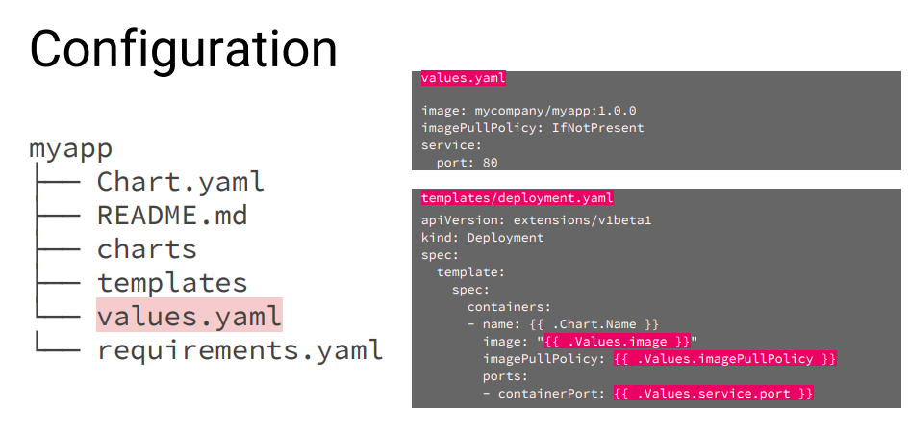

Helm – Values and Templates

Slide 76
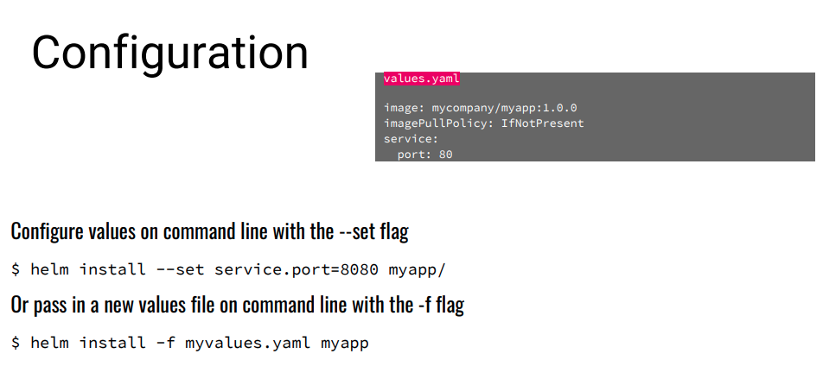
Helm – Values and Templates

Slide 77
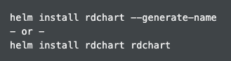
v3 Overview
Based on community best practices
Dramatic simplification
Architectural changes (security as priority)
Removal of Tiller
Name (or --generate-name) is now required on install
https://helm.sh/docs/faq/
Notes:
Helm 2 was already simple. If we install the same Helm chart with Helm 2 and Helm 3, the application installed will be precisely the same, just as we would expect! So, what’s the motivation behind Helm 3? Helm 3 is the result of years of community contributions and feedback around how orgs are using Helm and how they need it to evolve for their production use cases. Helm 3 represents a nearly complete re-factoring of the Helm package manager to evolve it from its origins to a modern application package manager. The Helm project is nearly as old as Kubernetes itself. As a result, its original design pre-dated many advancements in Kubernetes like CustomResourceDefinitions and even Kubernetes RBAC.

Slide 78
Helm – Resources
Documentation: helm.sh/docs
Video: Helm Intro
Video: Helm 3 Deep Dive
Helm Charts on GitHub

Slide 79
Challenge 9
Helm
Deploy the application using Helm

Slide 80
Kubernetes Networking DNS and Ingress This is as far as I’ve gotten (PF)

Slide 81
Networking in Kubernetes
Kubernetes Networking model introduces 3 methods of communications:
Pod-to-Pod communication directly by IP address. Kubernetes has a Pod-IP wide metric simplifying communication.
Pod-to-Service Communication – Client traffic is directed to service virtual IP by iptables rules that are modified by the kube-proxy process (running on all hosts) and directed to the correct Pod.
External-to-Internal Communication – external access is captured by an external load balancer which targets nodes in a cluster. The Pod-to-Service flow stays the same.
Notes:
When the backend Service is created, the Kubernetes master assigns a virtual IP address, for example 10.0.0.1. Assuming the Service port is 1234, the Service is observed by all of the kube-proxy instances in the cluster. When a proxy sees a new Service, it installs a series of iptables rules which redirect from the VIP to per-Service rules. The per-Service rules link to per-Endpoint rules which redirect (Destination NAT) to the backends.
When a client connects to the VIP the iptables rule kicks in. A backend is chosen (either based on session affinity or randomly) and packets are redirected to the backend. Unlike the userspace proxy, packets are never copied to userspace, the kube-proxy does not have to be running for the VIP to work, and the client IP is not altered.
This same basic flow executes when traffic comes in through a node-port or through a load-balancer, though in those cases the client IP does get altered.

Slide 82
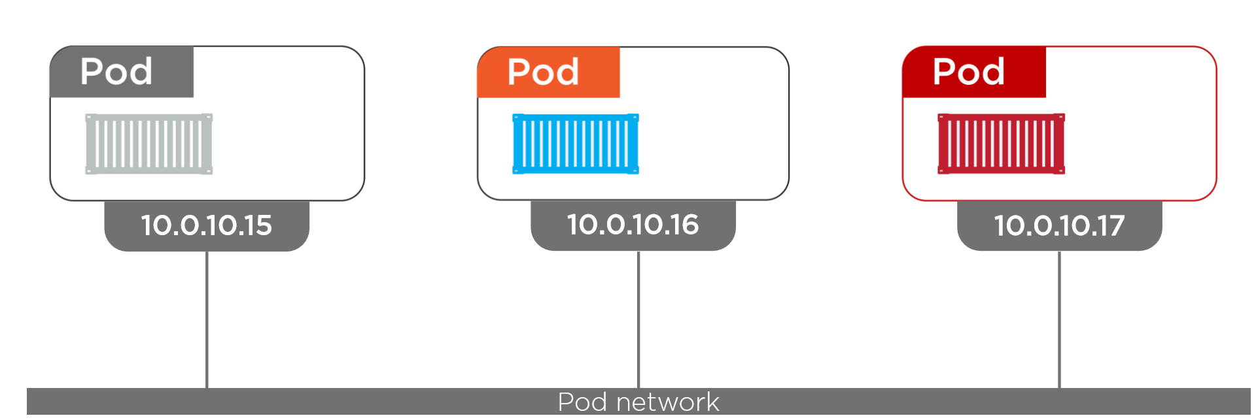
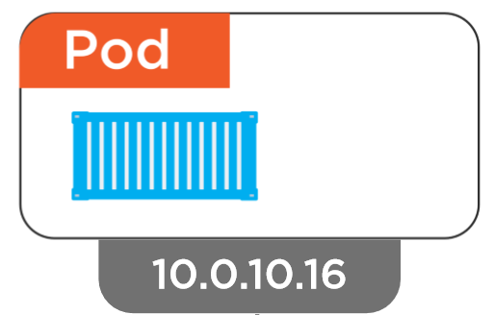
Networking – Pod
Inter-Pod Communication
Notes:
Pods are the unit of deployment in k8s
Each pod get an IP address and each pods can communicate each other in the Pod Network provided by K8s regardless of nodes

Slide 83
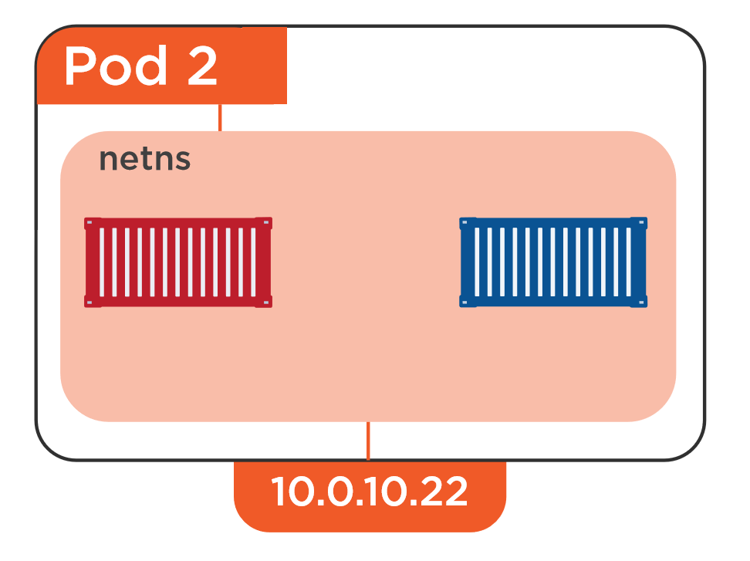
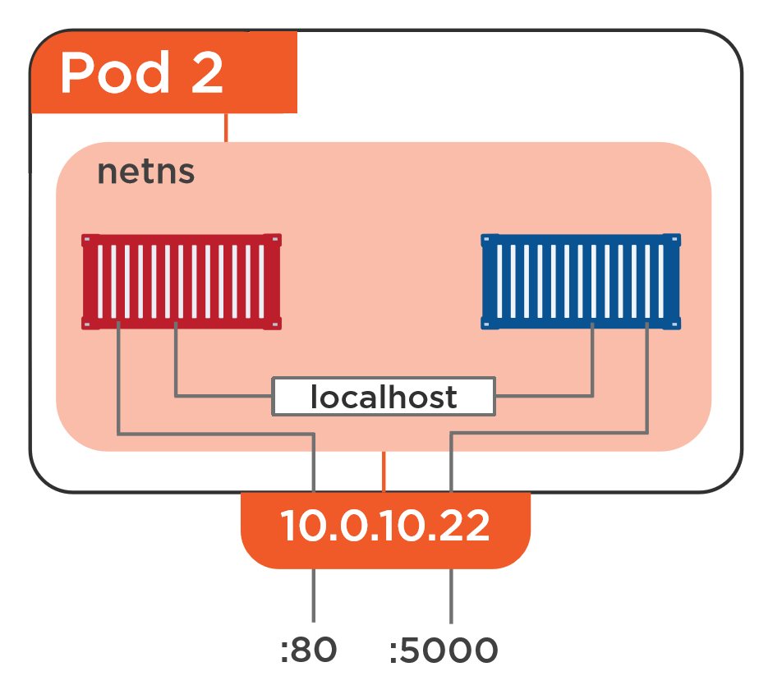
Networking - Pod
Inter-Pod Communication
Notes:
There can be one or more containers in a single pod
By default each container can communicate with other via localhost with port number
If we need to access a specific app in a one of those container then can use the Pod IP : Port number

Slide 84
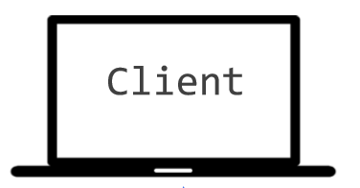

Networking - Service
Why Service ?
10.0.10.1
10.0.10.2
10.0.10.3
10.0.10.10
10.0.10.4

Slide 85
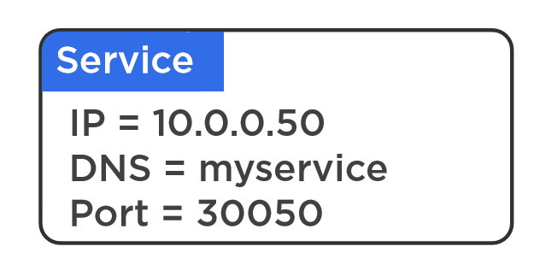
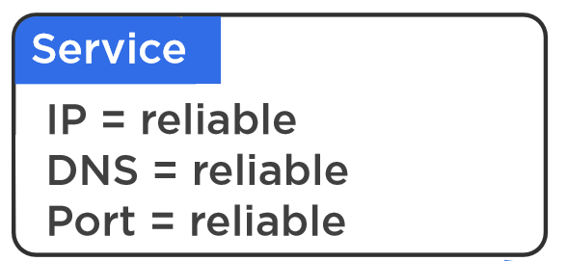
Networking – Service
Why Service ?
10.0.10.1
10.0.10.2
10.0.10.3
10.0.10.4

Slide 86
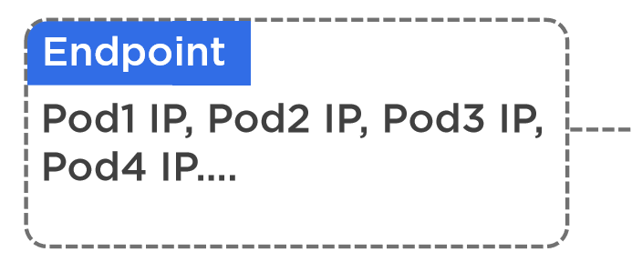
Networking - Service
How does Service Works
Name : Foo
Type : API
10.0.10.1
10.0.10.2
10.0.10.3
10.0.10.4
10.0.10.5
10.0.10.6
Name : Foo
Name : Foo
Name : Foo
Name : Foo
Name : Bar
Name : Bar
Type : API
Type : API
Type : API
Type : API
Type : Database
Type : Database

Slide 87
Different Type of Services
ClusterIP (default)
NodePort
LoadBalancer

Slide 88
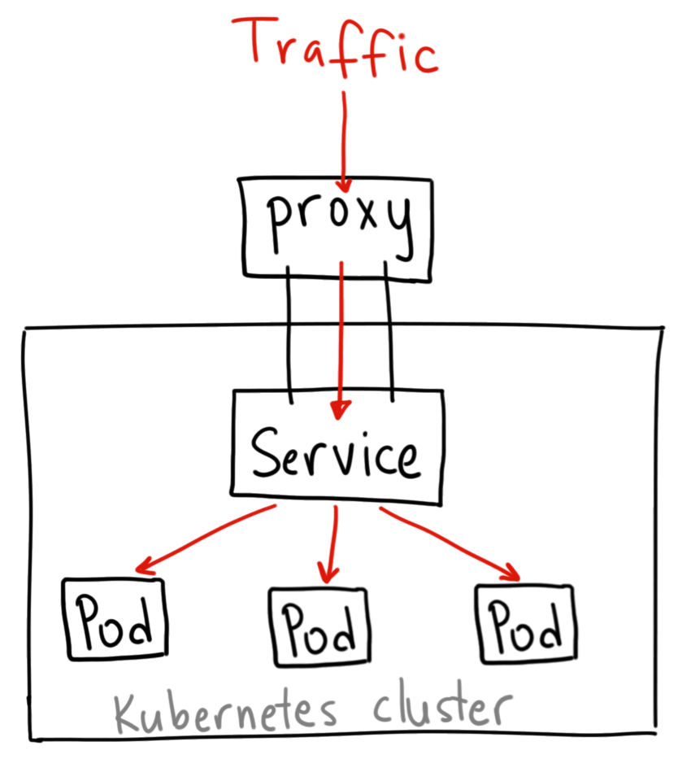
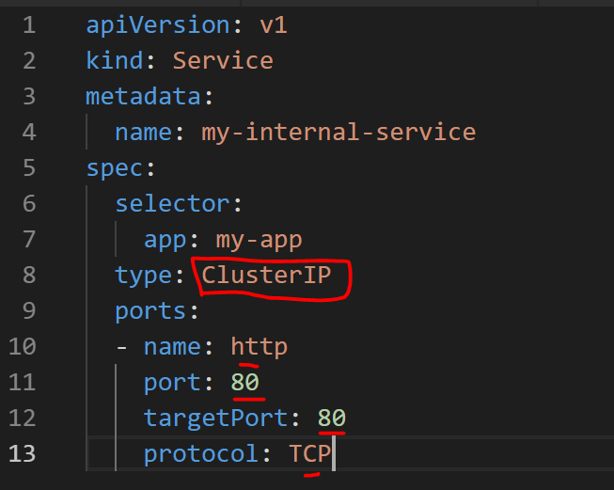
Networking – Service : ClusterIP
How does ClusterIP Service Works
Notes:
A ClusterIP service is the default Kubernetes service. It gives you a service inside your cluster that other apps inside your cluster can access. There is no external acces
When would you use this?
There are a few scenarios where you would use the Kubernetes proxy to access your services.
Grouping pods into subset of services, e.g all Foo API pods , Foo database pods, Foo Web Front Pods etc..
Debugging your services, or connecting to them directly from your laptop for some reason
Allowing internal traffic, displaying internal dashboards, etc.

Slide 89
Networking – Service : ClusterIP
How does ClusterIP Service Works
Notes:
A ClusterIP service is the default Kubernetes service. It gives you a service inside your cluster that other apps inside your cluster can access. There is no external acces
When would you use this?
There are a few scenarios where you would use the Kubernetes proxy to access your services.
Grouping pods into subset of services, e.g all Foo API pods , Foo database pods, Foo Web Front Pods etc..
Debugging your services, or connecting to them directly from your laptop for some reason
Allowing internal traffic, displaying internal dashboards, etc.

Slide 90
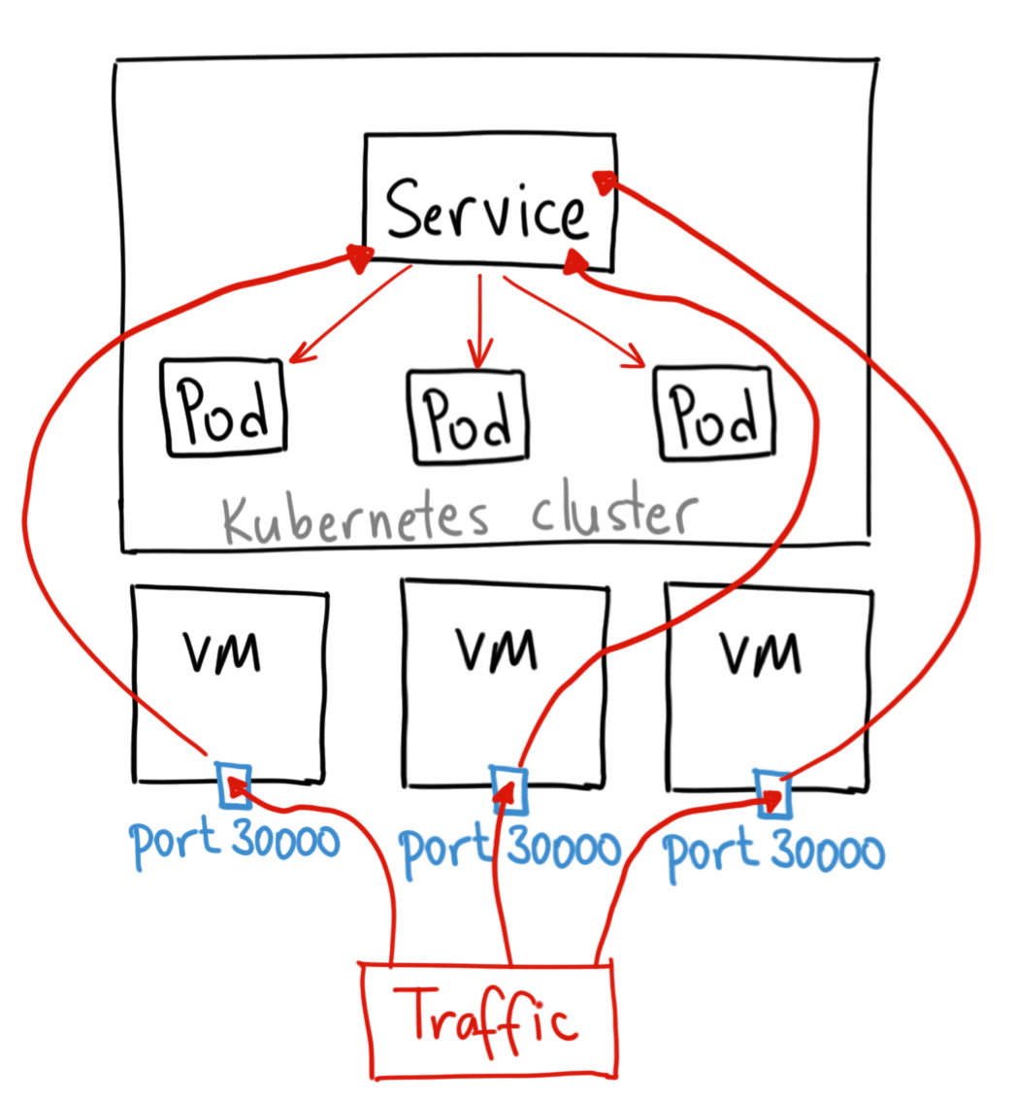
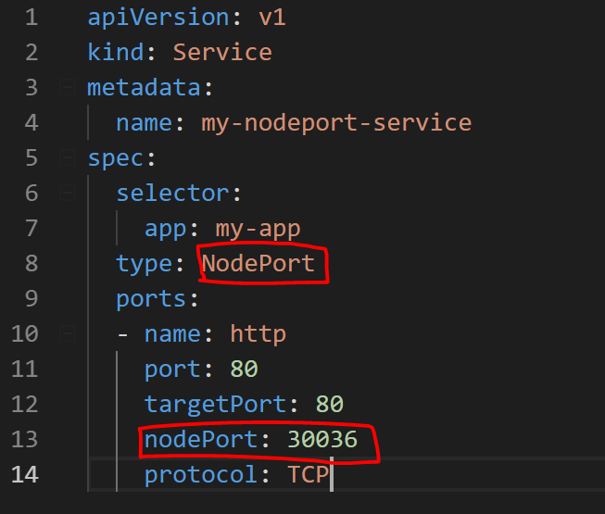
Networking – Service : NodePort
How does NodePort Service Works
Notes:
A NodePort service is the most primitive way to get external traffic directly to your service. NodePort, as the name implies, opens a specific port on all the Nodes (the VMs), and any traffic that is sent to this port is forwarded to the service.
Basically, a NodePort service has two difference from a normal “ClusterIP” service. First, the type is “NodePort.” There is also an additional port called the nodePort that specifies which port to open on the nodes. If you don’t specify this port, it will pick a random port. Most of the time you should let Kubernetes choose the port;
There are many downsides to this method:
You can only have once service per port
You can only use ports 30000–32767
If your Node/VM IP address change, you need to deal with that
For these reasons, I don’t recommend using this method in production to directly expose your service. If you are running a service that doesn’t have to be always available, or you are very cost sensitive, this method will work for you. A good example of such an application is a demo app or something temporary.

Slide 91
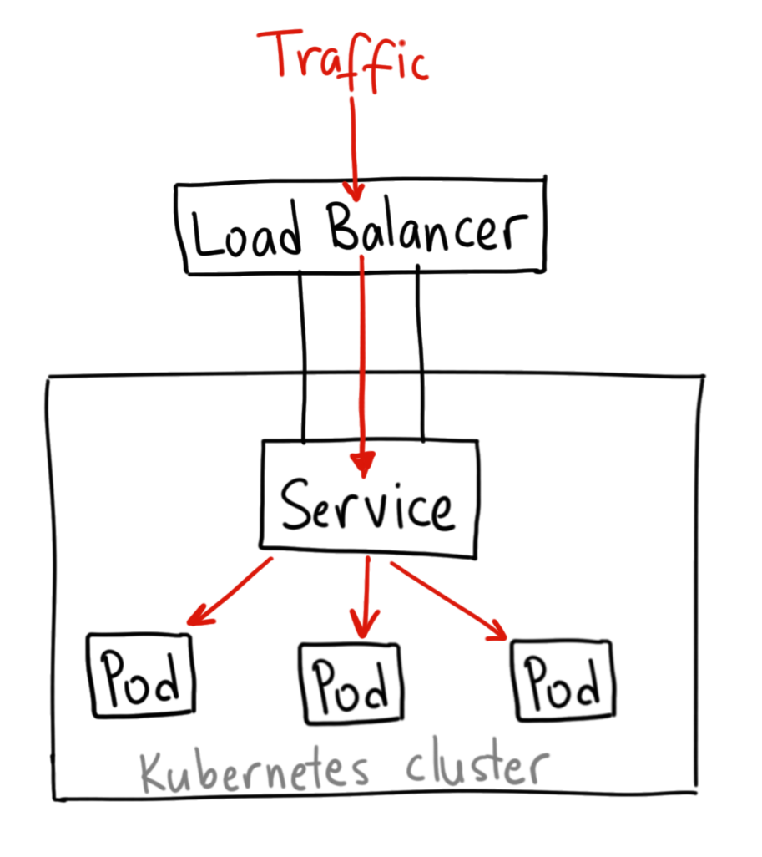
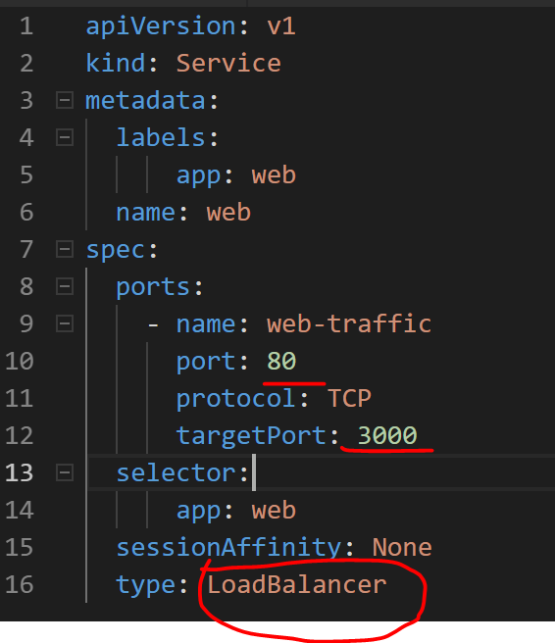
Networking – Service : Loadbalancer
How does Loadbalancer Service Works
Notes:
A LoadBalancer service is the standard way to expose a service to the internet. On AKS, uses the Azure Load Balancer that will give you a single IP address that will forward all traffic to your service.
When would you use this?
If you want to directly expose a service, this is the default method. All traffic on the port you specify will be forwarded to the service. There is no filtering, no routing, etc. This means you can send almost any kind of traffic to it, like HTTP, TCP, UDP, Websockets, gRPC, or whatever.
The big downside is that each service you expose with a LoadBalancer will get its own IP address, and you have to pay for a LoadBalancer per exposed service, which can get expensive!

Slide 92
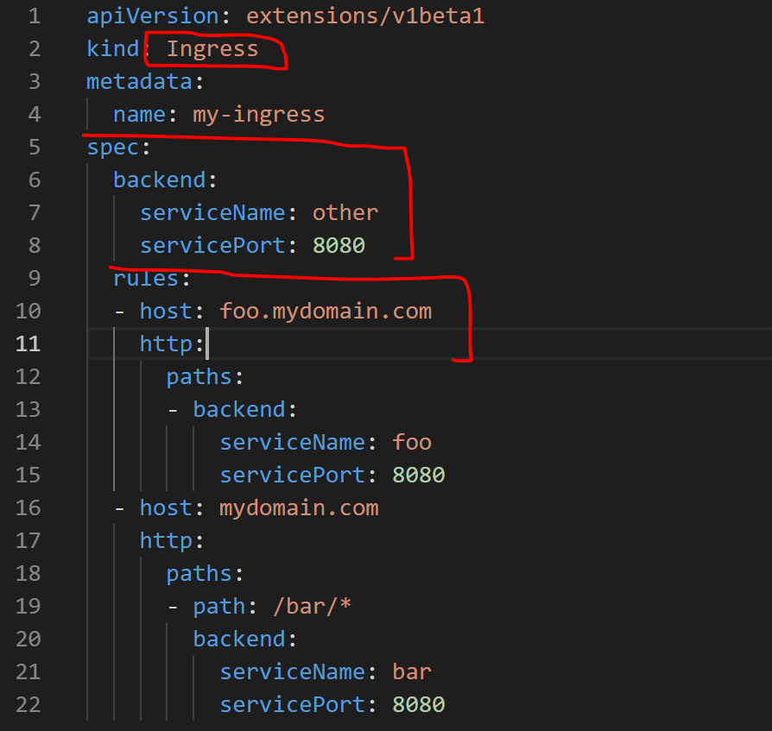
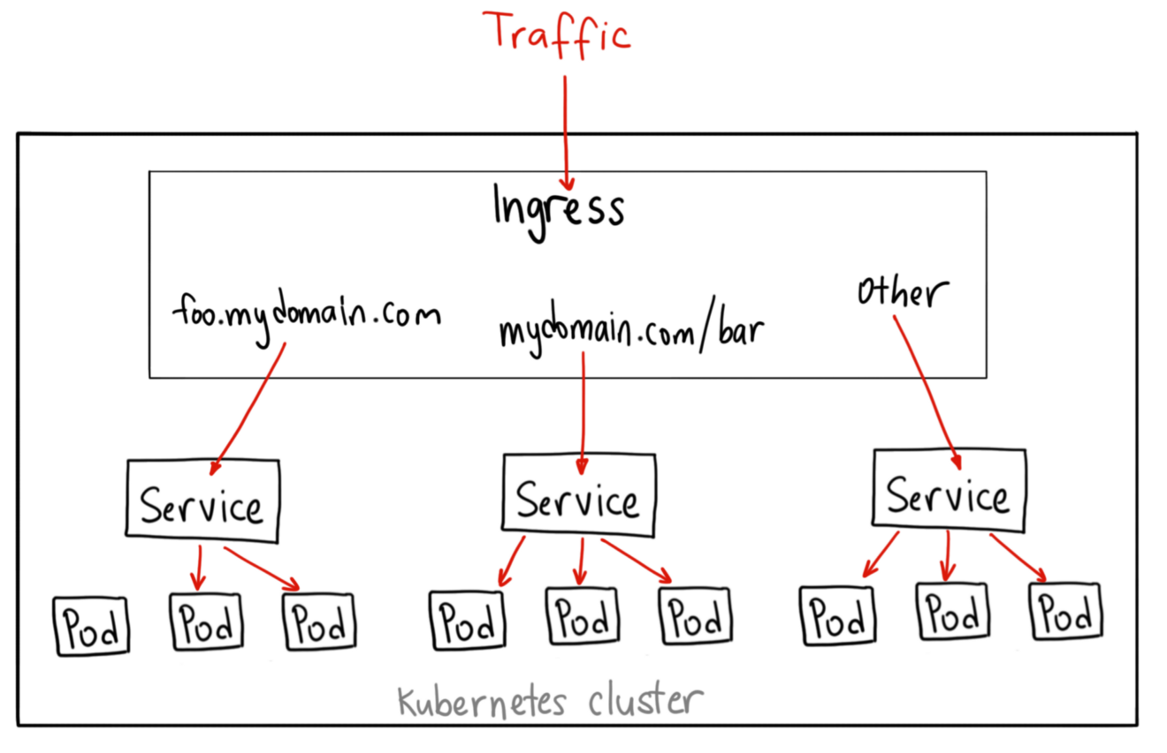
Networking – Ingress
How does Ingress Controller Works
Notes:
Unlike all the previous service examples, Ingress is actually NOT a type of service. Instead, it sits in front of multiple services and act as a “smart router” or entrypoint into your cluster.
You can do a lot of different things with an Ingress, and there are many types of Ingress controllers that have different capabilities.
When would you use this?
Ingress is probably the most powerful way to expose your services, but can also be the most complicated. There are many types of Ingress controllers, from the Google Cloud Load Balancer, Nginx, Contour, Istio, and more.
There are also plugins for Ingress controllers, like the cert-manager, that can automatically provision SSL certificates for your services.
Ingress is the most useful if you want to expose multiple services under the same IP address, and these services all use the same L7 protocol (typically HTTP). You only pay for one load balancer if you are using the native GCP integration, and because Ingress is “smart” you can get a lot of features out of the box (like SSL, Auth, Routing, etc)

Slide 93
AKS Networking
Basic (Kubenet)
Provisions its own VNET and only exposes Public IPs
Pods IPs get only cluserIPs and accessible only within the cluster
Publicly exposed services accessible outside the cluster
Max Pods per node 110
Advanced (Azure CNI)
Uses an existing VNET and expose private IPs
Pods & Services get private IPs
Max pods per node 110 (CLI / ARM, Portal - 30)
"networkPlugin": {
"type": "string",
"allowedValues": [
"azure",
"kubenet"
],
"metadata": {
"description": "Network plugin used for building Kubernetes network."
}
},
Notes:
CNCF = Cloud Native Computing Foundation
https://github.com/Azure/azure-container-networking/blob/master/docs/acs.md

Slide 94
Container Network Interface (CNI)
CNI (a CNCF project) is a spec for plugins to configure Linux container network interfaces
Wide range of support
Kubernetes, OpenShift, Cloud Foundry, Mesos, rkt, etc.
Examples
Calico, Weave, Contiv, etc.
Azure CNI plug-in integrates Azure VNET into kubernetes clusters
Notes:
CNCF = Cloud Native Computing Foundation
https://github.com/Azure/azure-container-networking/blob/master/docs/acs.md

Slide 95
Challenge 10
Networking
Enable AKS Http Application Routing
Deploy web app with ingress controller based out of Http Application Routing
Optional:
Set custom DNS prefix
Verify the DNS records are created successfully
Test external access of the application using the DNS name of the web app
Notes:
HTTP routing solution overview
The add-on deploys two components: a Kubernetes Ingress controller and an External-DNS controller.
Ingress controller: The Ingress controller is exposed to the internet by using a Kubernetes service of type LoadBalancer. The Ingress controller watches and implements Kubernetes Ingress resources, which creates routes to application endpoints.
External-DNS controller: Watches for Kubernetes Ingress resources and creates DNS A records in the cluster-specific DNS zone.

Slide 96
Operationalizing K8S Monitoring and Logging

Slide 97
Monitoring
Kubernetes monitoring provides us with the ability to view what is happening within the cluster nodes, pods and containers.
Benefits:
View application logs.
Identify resource bottlenecks.
View the cluster's overall performance.
Review the resource utilization of workloads running on the host that are unrelated to the standard processes that support the pod.
Understand the behavior of the cluster under average and heaviest loads.
Identify capacity needs and determine the maximum load that the cluster can sustain.

Slide 98
Logging and Troubleshooting
Viewing full logs for pods and services:
kubectl logs
There are various ways to troubleshoot:
Finding out why pods are failing:
kubectl describe pod
Getting a bash shell into a running container in a pod:
kubectl exec

Slide 99
Challenge 11
Deploying Monitoring Tools and Troubleshooting
Find the logs for your application’s containers
Start a bash shell into a container and check the list of running processes
Find out if your pods had any errors.
Enable Azure Monitoring for Containers

Slide 100

Current monitoring is static in nature

Slide 101
Need to monitor for dynamic environments
Pod
Pod
Pod
Pod
Pod
Pod
Pod
Pod
Pod
Pod
Pod
Pod
Pod
Pod
Pod
Pod

Slide 102
Application Health and Readiness
Kubelets on workers use liveness and readiness probes to know when to restart a container or start directing traffic
Liveness check: when to restart
Readiness check: when to forward Service traffic to a pod
Notes:
Look at liveness
Look at readiness

Slide 103
Monitoring: What indicators matter in Kubernetes
Cluster health: total number of nodes, pods, etc
Node health: available compute resources, health
Application health
Tooling Examples
Datadog
Prometheus
InfluxData
Cloud-specific: OMS (Azure), CloudWatch (AWS)
Notes:
https://docs.datadoghq.com/integrations/kubernetes/

Slide 104
Logging
Pod logs: applications must log to standard out!
Cluster-wide event logs
Logging forwarder solutions
fluentd
logstash
Log indexers
OMS Log Analytics
Splunk
ELK stack

